Slide 1
The web, under the hood
By Shahbaz Chaudhary

Slide 2

What happens when you visit a website?

Slide 3



The browser appends a port number: 80
http://uchicago.edu:80

Slide 4

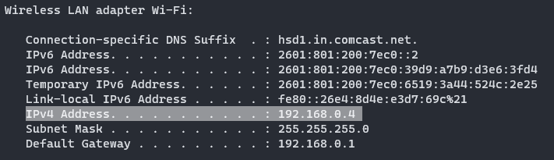
Detour: ports and IP addresses (simplified)
Each computer on a network has a unique IP address. The internet is made up of many networks. Get your current address by using the ifconfig (or ipconfig) command.
A machine may be running many servers: web server, time server, ssh server, etc.
How do we differentiate among services?
Using ports!
http (web): port 80
ssh: port 22
ntp (etwork time protocol): port 123
68.45.56.20

Slide 5
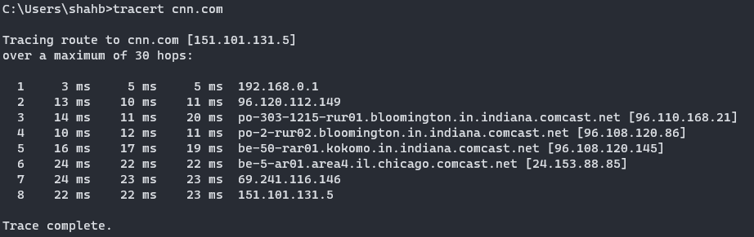
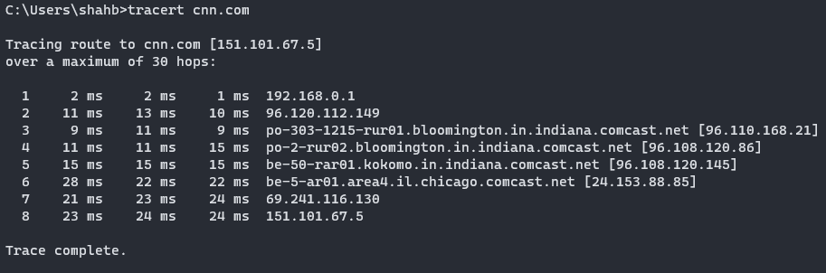
Modern internet uses packets while old phone network was a very long cable
Notice that data going from your computer to a remote server can take different paths (tracert or traceroute)
The ability to take different routes means the network is route around damaged nodes.
Makes sense, since the original network was designed to survive nuclear war!
Pro-tip: check if a machine is down by doing ping machine_ip

Slide 6
HTML, CSS and JavaScript

Slide 7

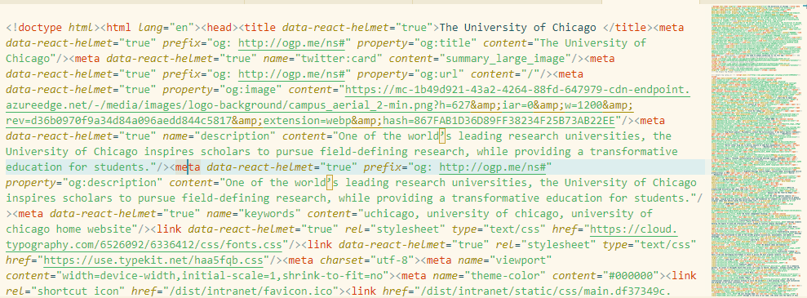
What exactly is a web page?
Try “View page source” or open developer tools to get a peek at the code

Slide 8
HTML (Hyper text markup language) contains the content of a web page
<html>
<head>
<link rel="stylesheet" href="css/layout.css" type="text/css">
<script type="text/javascript" src="script.js"></script>
</head>
<body>
<p> This is a paragraph. It can contain a block of text and can
contain multiple lines </p> HTML can contain <a href="http://uchicago.edu"> links </a>.
</body>
</html>
HTML is a markup language, not a full language like Python or Javascript. (This is not a value judgement)

Slide 9
CSS (Cascading Style Sheets) controls the look & feel (and behavior) of HTML
/* https://www.w3schools.com/css/ */
body {
background-color: lightblue;
}
h1 {
color: white;
text-align: center;
}
p {
font-family: verdana;
font-size: 20px;
}
Web developers often let the designers work with CSS. Non-designers, such as myself, often use CSS frameworks, such as Bootstrap or Tailwind.
See developer tools for a full list of CSS properties

Slide 10
Javascript is the official programming language of the web (and the only one*)
//https://www.w3schools.com/jsref/event_onclick.asp
<h3 id="demo" onclick="myFunction()">Click me to change my color.</h3>
<script>
function myFunction() {
document.getElementById("demo").style.color = "red";
}
</script>
* Newer technologies such as WASM will allow more and more languages to be available

Slide 11
There are convenient online tools to test http + css + js
https://jsfiddle.net/
https://jsbin.com/?html,output

Slide 12

Web pages can be dynamically generated
from datetime import datetime
from flask import Flask
app = Flask(__name__)
@app.route("/")
def hello_world():
return f"<p>Current time:{datetime.now().strftime("%H:%M")}</p>"
Python
(server side)
Generated HTML
(server side)
<p>Current time: 2:11</p>
Browser view
(client side)
Current time: 2:11

Slide 13
Web URLs contain lots of information
protocol (http or https)
http://somewebsite.com
site address
route
http://somewebsite.com/section_a/item_c
parameter names and values
http://somewebsite.com/section_a/item_c?param_a=val1&param_b=val2

Slide 14
Hands on keyboard …

Slide 15
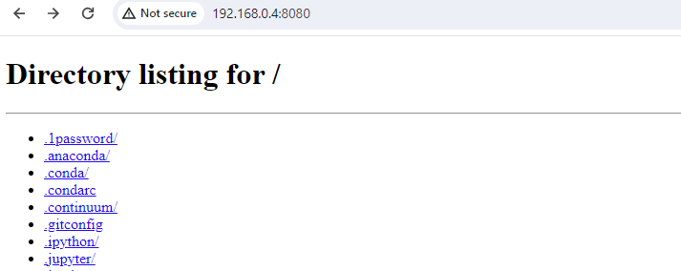
Run your own web server python –m http.server 8080
What url can you type in your browser to view your local “web site?”
Get the assigned IP using ipconfig or ifconfig
Visit that url in the browser (remember to add the port)
Connection-specific DNS Suffix . : hsd1.in.comcast.net.
IPv6 Address. . . . . . . . . . . : 2601:801:200:7ec0::2
IPv6 Address. . . . . . . . . . . : 2601:801:200:7ec0:39d9:a7b9:d3e6:3fd4
Temporary IPv6 Address. . . . . . : 2601:801:200:7ec0:6519:3a44:524c:2e25
Link-local IPv6 Address . . . . . : fe80::26e4:8d4e:e3d7:69c%21
IPv4 Address. . . . . . . . . . . : 192.168.0.4
Subnet Mask . . . . . . . . . . . : 255.255.255.0
Default Gateway . . . . . . . . . : 192.168.0.1

Slide 16
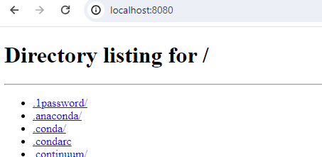
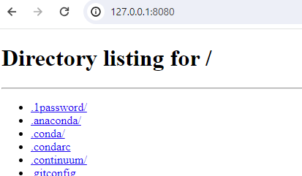
Just use special names: 127.0.0.1 or localhost

Slide 17
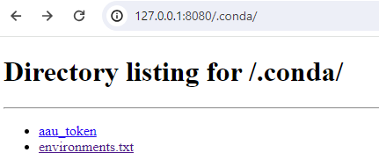
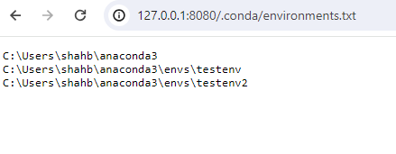
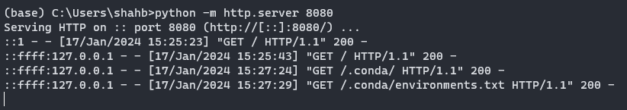
Look at the server logs
Each time the browser asks for more information, the server displays the log for it
The server prints the
- IP address]
- the date and time
- “GET”
- the route
- “HTTP/1.1”
- 200

Slide 18
HTTP protocol

Slide 19
Web log contents
::ffff:127.0.0.1 - - [17/Jan/2024 15:25:43] "GET / HTTP/1.1" 200 -
::ffff:127.0.0.1 - - [17/Jan/2024 15:27:24] "GET /.conda/ HTTP/1.1" 200 -
::ffff:127.0.0.1 - - [17/Jan/2024 15:27:29] "GET /.conda/environments.txt HTTP/1.1" 200 -
GET
The HTTP protocol defines some methods, such as GET, POST, PUT, DELETE. GET translates to “read a resources at the given route”
/.conda/environments.txt
This is the route and the resource requested by the browser
HTTP/1.1
The HTTP protocol version specifics generally are negotiated by the browser and the server and are of little concern to developers
200
Each request from the browser results in a response from the server, along with a response code. 200 means everything is ok. Do you know the code for a resource which isn’t found? 404!

Slide 20
What is exchanged between your browser and the server?
Open a network connection (provides IP to the server)
Server
Browser
HTTP GET request for a route
HTTP response header
HTTP response content

Slide 21
What is exchanged between your browser and the server?
1. Browser request
2. Server response header
GET /.conda/ HTTP/1.1
Accept: text/html,application/xhtml+xml,application/xml;q=0.9,image/avif,image/webp,image/apng,*/*;q=0.8,application/signed-exchange;v=b3;q=0.7
Accept-Encoding: gzip, deflate, br
Accept-Language: en-US,en;q=0.9
Cache-Control: max-age=0
Connection: keep-alive
Host: 127.0.0.1:8080
Referer: http://127.0.0.1:8080/
Sec-Fetch-Dest: document
Sec-Fetch-Mode: navigate
Sec-Fetch-Site: same-origin
Sec-Fetch-User: ?1
Upgrade-Insecure-Requests: 1
User-Agent: Mozilla/5.0 (Windows NT 10.0; Win64; x64) AppleWebKit/537.36 (KHTML, like Gecko) Chrome/120.0.0.0 Safari/537.36
sec-ch-ua: "Not_A Brand";v="8", "Chromium";v="120", "Google Chrome";v="120"
sec-ch-ua-mobile: ?0
sec-ch-ua-platform: "Windows"
HTTP/1.0 200 OK
Server: SimpleHTTP/0.6 Python/3.11.5
Date: Wed, 17 Jan 2024 21:45:21 GMT
Content-type: text/html; charset=utf-8
Content-Length: 301
3. Server response body
<!DOCTYPE HTML>
<html lang="en">
<head>
<meta charset="utf-8">
<title>Directory listing for /.conda/</title>
</head>
<body>
<h1>Directory listing for /.conda/</h1>
<hr>
<ul>
<li><a href="aau_token">aau_token</a></li>
<li><a href="environments.txt">environments.txt</a></li>
</ul>
<hr>
</body>
</html>

Slide 22
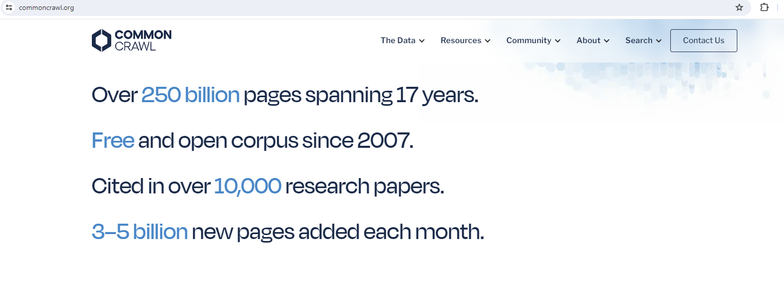
BTW: Common Crawl provides billions of web pages and the request/response headers

Slide 23
A closer look at the HTTP request Browser to the server
GET /.conda/ HTTP/1.1
Accept: text/html,application/xhtml+xml,application/xml;q=0.9,image/avif,image/webp,image/apng,*/*;q=0.8,application/signed-exchange;v=b3;q=0.7
Accept-Encoding: gzip, deflate, br
Accept-Language: en-US,en;q=0.9
Cache-Control: max-age=0
Connection: keep-alive
Host: 127.0.0.1:8080
Referer: http://127.0.0.1:8080/
Sec-Fetch-Dest: document
Sec-Fetch-Mode: navigate
Sec-Fetch-Site: same-origin
Sec-Fetch-User: ?1
Upgrade-Insecure-Requests: 1
User-Agent: Mozilla/5.0 (Windows NT 10.0; Win64; x64) AppleWebKit/537.36 (KHTML, like Gecko) Chrome/120.0.0.0 Safari/537.36
sec-ch-ua: "Not_A Brand";v="8", "Chromium";v="120", "Google Chrome";v="120"
sec-ch-ua-mobile: ?0
sec-ch-ua-platform: "Windows"

Slide 24
A closer look at the HTTP response Server to the browser
Header
Body
HTTP/1.0 200 OK
Server: SimpleHTTP/0.6 Python/3.11.5
Date: Wed, 17 Jan 2024 21:45:21 GMT
Content-type: text/html; charset=utf-8
Content-Length: 301
<!DOCTYPE HTML>
<html lang="en">
<head>
<meta charset="utf-8">
<title>Directory listing for /.conda/</title>
</head>
<body>
<h1>Directory listing for /.conda/</h1>
<hr>
<ul>
<li><a href="aau_token">aau_token</a></li>
<li><a href="environments.txt">environments.txt</a></li>
</ul>
<hr>
</body>
</html>

Slide 25
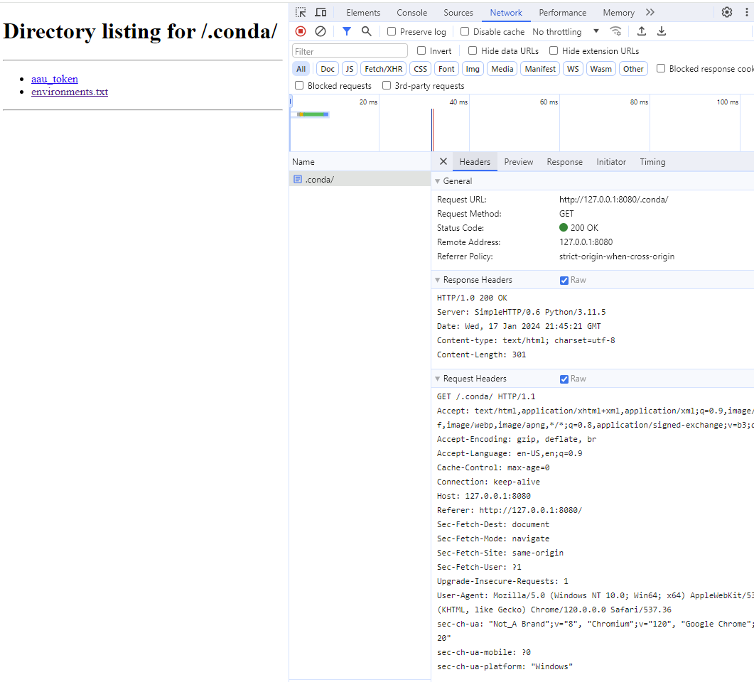
What is exchanged between your browser and the server?
The HTTP protocol is a text based protocol. It is easy to parse, easy to debug and easy to wrap in libraries of any language

Slide 26
Closer look at HTTP methods
::ffff:127.0.0.1 - - [17/Jan/2024 15:25:43] "GET / HTTP/1.1" 200 -
::ffff:127.0.0.1 - - [17/Jan/2024 15:27:24] "GET /.conda/ HTTP/1.1" 200 -
::ffff:127.0.0.1 - - [17/Jan/2024 15:27:29] "GET /.conda/environments.txt HTTP/1.1" 200 -
GET
The HTTP protocol defines some methods, such as GET, POST, PUT, DELETE. GET translates to “read a resources at the given route”
The http protocol provides four methods
Method | CRUD | Web developer description | Data scientist description
POST | Create | Create new resource | Can submit data, such as inputs to a model
GET | Read | Retrieves web pages at a given route | Normal web request
PUT | Update | Update a resource | Not relevant
DELETE | Delete | Remove a resource | Not relevant

Slide 27
HTTP methods: GET and POST
We have seen that GET is the same as a standard web request
http://somewebsite.com/section_a/item_b?param1=value&param2=value
If we are building a prediction service, the inputs to the model can just be the arguments param1 and param2?
A more generally accepted method is to use POST. POST allows clients to submit a JSON* object as a “payload,” along with the url.
http://somewebsite.com/section_a/item_b
{param1:value, param2:value}
Parameters encoded in the URL, as with GET, have space limits and often need to encode special characters. POST removes such limitations.
*POST is not limited to JSON, it can be any data

Slide 28
HTTP libraries

Slide 29
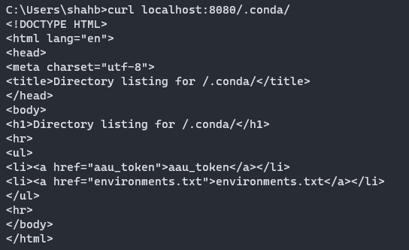
Practically every language has libraries for writing http clients and servers
You can even use the command line to access a simple http resource:
curl http://127.0.0.1:8080/.conda/

Slide 30
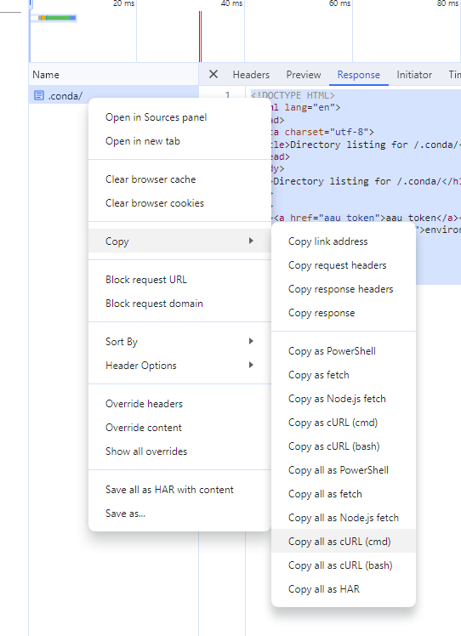
Practically every language has libraries for writing http clients and servers
You can even use the command line to access a not so simple http resource:
curl "http://127.0.0.1:8080/.conda/" ^
-H "Accept: text/html,application/xhtml+xml,application/xml;q=0.9,image/avif,image/webp,image/apng,*/*;q=0.8,application/signed-exchange;v=b3;q=0.7" ^
-H "Accept-Language: en-US,en;q=0.9" ^
-H "Cache-Control: max-age=0" ^
-H "Connection: keep-alive" ^
-H "Referer: http://127.0.0.1:8080/" ^
-H "Sec-Fetch-Dest: document" ^
-H "Sec-Fetch-Mode: navigate" ^
-H "Sec-Fetch-Site: same-origin" ^
-H "Sec-Fetch-User: ?1" ^
-H "Upgrade-Insecure-Requests: 1" ^
-H "User-Agent: Mozilla/5.0 (Windows NT 10.0; Win64; x64) AppleWebKit/537.36 (KHTML, like Gecko) Chrome/120.0.0.0 Safari/537.36" ^
-H "sec-ch-ua: ^\^"Not_A Brand^\^";v=^\^"8^\^", ^\^"Chromium^\^";v=^\^"120^\^", ^\^"Google Chrome^\^";v=^\^"120^\^"" ^
-H "sec-ch-ua-mobile: ?0" ^
-H "sec-ch-ua-platform: ^\^"Windows^\^"" ^
--compressed

Slide 31
cURL is an extremely versatile tool
Normal GET request
curl http://somewebsite.com/some_resource
POST request with a JSON payload
curl –X POST \
–H “Content-Type: application/json” \
–d “{param1:val, param2:val}” http://somewebsite.com/some_resource

Slide 32
Web services

Slide 33
If HTTP is supported by every language, every operating system, many browsers, even the command line, isn’t it also a great tool to exchange data?
That’s what web services are!

Slide 34

Web services: serve data, instead of web pages (… but text?)
#serve text
from datetime import datetime
from flask import Flask, request, send_from_directory
app = Flask(__name__)
@app.get('/get_time')
def get_time():
t = f'"current_time":"{datetime.now().strftime("%H:%M")}"'
return t
if __name__=='__main__':
app.run(debug=True, port=5000) #host='0.0.0.0' <= Listen to all traffic, not just local

Slide 35
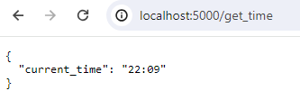
Web services: serve JSON
#serve json
from datetime import datetime
from flask import Flask, request, send_from_directory, jsonify
app = Flask(__name__)
@app.get('/get_time')
def get_time():
d = {'current_time':datetime.now().strftime("%H:%M")}
return jsonify(d)
if __name__=='__main__':
app.run(debug=True, port=5000)

Slide 36
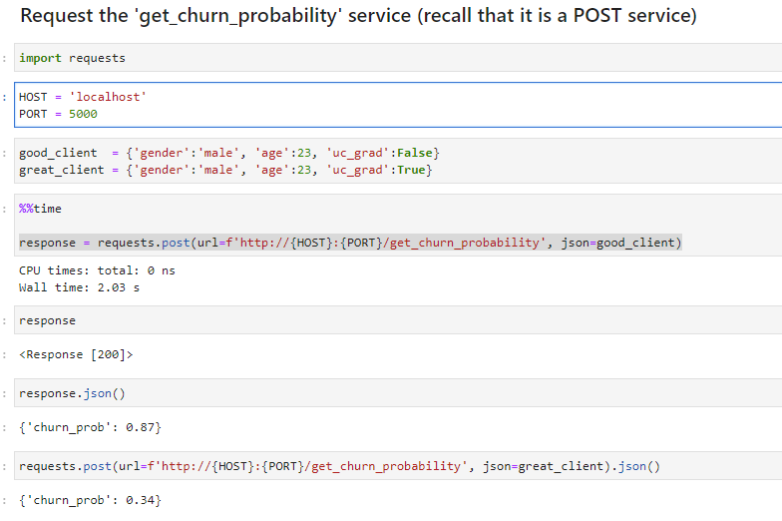
A web services system produces and consumes JSON over HTTP
from flask import Flask, request, send_from_directory, jsonify
app = Flask(__name__)
@app.post('/get_churn_probability')
def get_churn_probability():
client_properties = request.get_json() #if 'UC_GRAD' not in client_properties:
# pass throw error
# Our churn model is fake
if client_properties['uc_grad']:
return jsonify({'churn_prob':0.34})
else:
return jsonify({'churn_prob':0.87})
if __name__=='__main__':
app.run(debug=True, port=5000)
See file 075_web_services_under_the_hood/serve_post_json.py
See notebook 075_web_services_under_the_hood/consume_services.ipynb

Slide 37
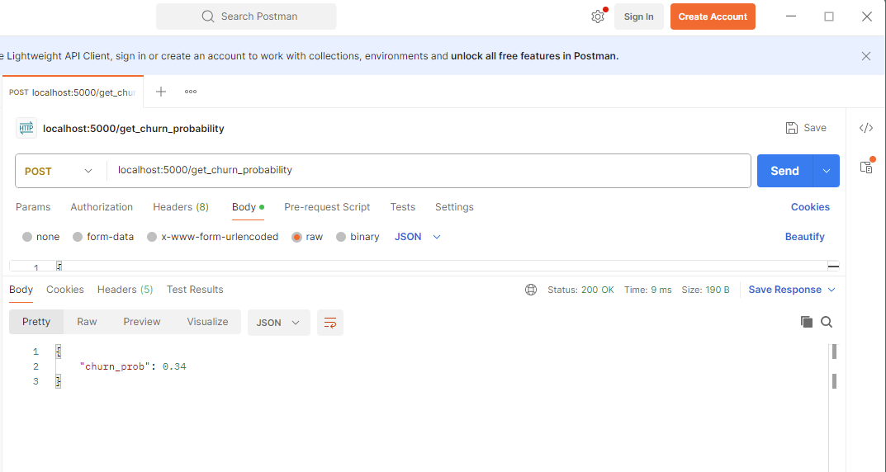
Testing web services without writing Python code
Windows (Power Shell)
Invoke-RestMethod -Uri http://localhost:5000/get_churn_probability -Method Post -Headers @{"Content-Type"="application/json"} -Body '{"gender": "male", "age": 23, "uc_grad":"False"}’
Mac/Linux
curl -X POST http://localhost:5000/get_churn_probability -H "Content-Type: application/json" -d '{"gender": "male", "age": 23, "uc_grad":"False"}'
Postman (https://www.postman.com/) is a great and often used GUI tool to test web services. Basic version is free

Slide 38
In-class exercise
Please write a small service which uses a POST method to accept two numbers, add them and return the result.
You should accept a JSON object like this: {num1:2, num2:3}
Be prepared to share your IP (ifconfig/ipconfig) and port with me so I (and others) can test your service.
Mac users:
curl -X POST http://localhost:5000/get_num -H "Content-Type: application/json" -d '{"x": 5, "y": 5}’
Windows (Power Shell) users:
Invoke-RestMethod -Uri http://localhost:5000/get_num -Method Post -Headers @{"Content-Type"="application/json"} -Body '{"x": 5, "y": 5}'

Slide 39
Web pages for humans
(web services for computers)

Slide 40
As data scientists, we use tools to generate HTML pages, such as: streamlit
1
Create streamlit_app.py
2
Edit it
import streamlit as st
st.write("Hello")
3
Run it
streamlit run streamlit_app.py
You can now view your Streamlit app in your browser.
Local URL: http://localhost:8501
Network URL: http://192.168.0.4:8501

Slide 41
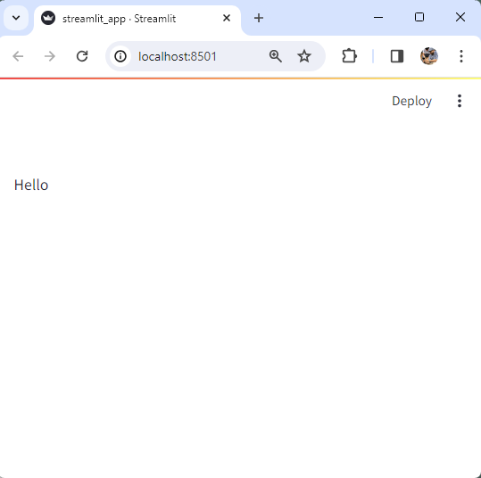
streamlit translates Python to HTML, reactively
import streamlit as st
st.write("Hello")

Slide 42
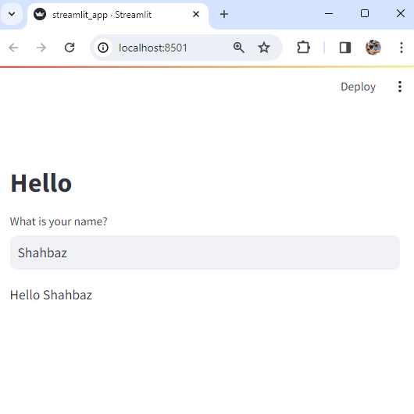
streamlit translates Python to HTML, reactively
import streamlit as st
st.markdown("# Hello")
name = st.text_input("What is your name?")
st.write(f"Hello {name}")

Slide 43
Code is not just executed linearly
import streamlit as st
st.markdown("# Hello")
name = st.text_input("What is your name?")
st.write(f"Hello {name}")
Notice how these variables are updated automatically?

Slide 44
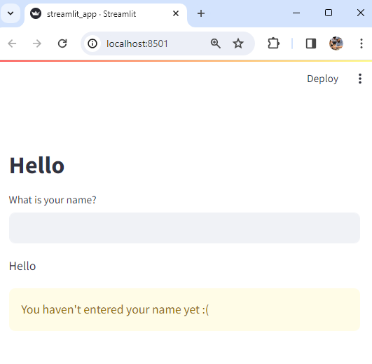
All code is executed, each time a variable changes (“reactive”)
import streamlit as st
st.markdown("# Hello")
name = st.text_input("What is your name?")
st.write(f"Hello {name}")
if len(name.strip()) == 0:
st.warning("You haven't entered your name yet :(")

Slide 45
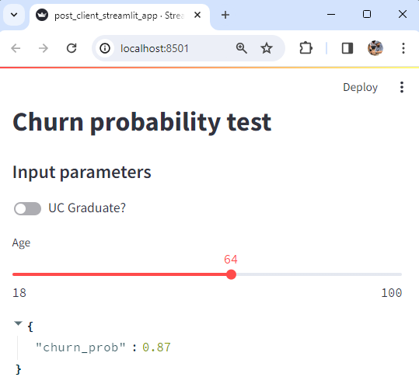
Build an interface to your web service See slide 36
import requests
import streamlit as st
st.markdown("# Churn probability test")
st.markdown("#### Input parameters")
uc_grad = st.toggle("UC Graduate?")
age = st.slider("Age", 18, 100)
response = requests.post(url=f"http://localhost:5000/get_churn_probability", json = {'gender':'male', 'age':age, 'uc_grad':uc_grad})
st.write(response.json())

Slide 46
See steramlit.io docs for a complete list of widgets
https://docs.streamlit.io/library/api-reference

Slide 47
Appendix

Slide 48
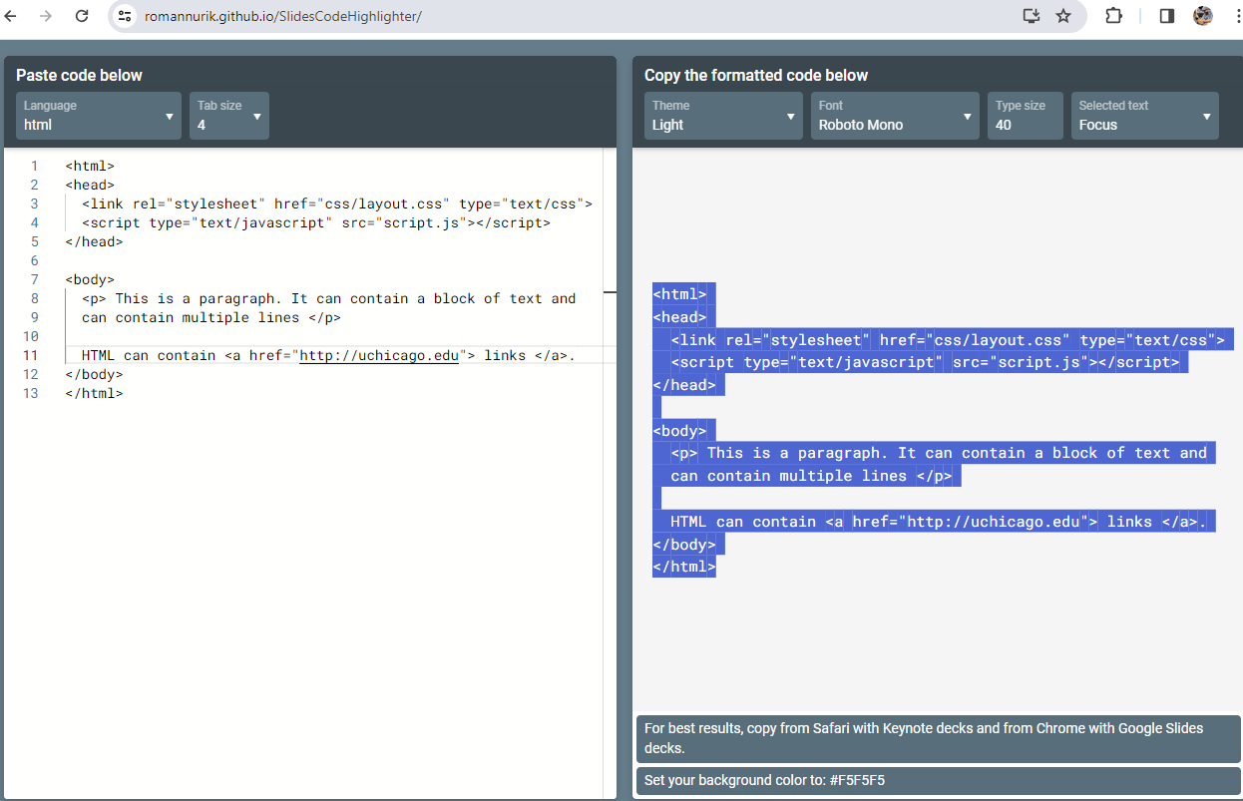
Syntax highlighting

